Slide 1
Bus Operator Work Bid Website Tutorial
Hastus Bid Web

Slide 2
Website address
https://bid.ridetransit.org

Slide 3
User Name and Password
User Name
Operators user names are their four digit employee IDs with a capital ‘B’ in front.
Example;
B0126
B0481
B6742
B7455
B8456
Password
Your password is a combination of your personal information
First two letters of your last name, first letter capitalized
10 digit phone number
Example;
Operator;
John Smith 704-555-1234
Password;
Sm7045551234

Slide 4
SelfService Home Page
Self Service Menu Options
Employee Name
Log Out Button
Available Bids

Slide 5
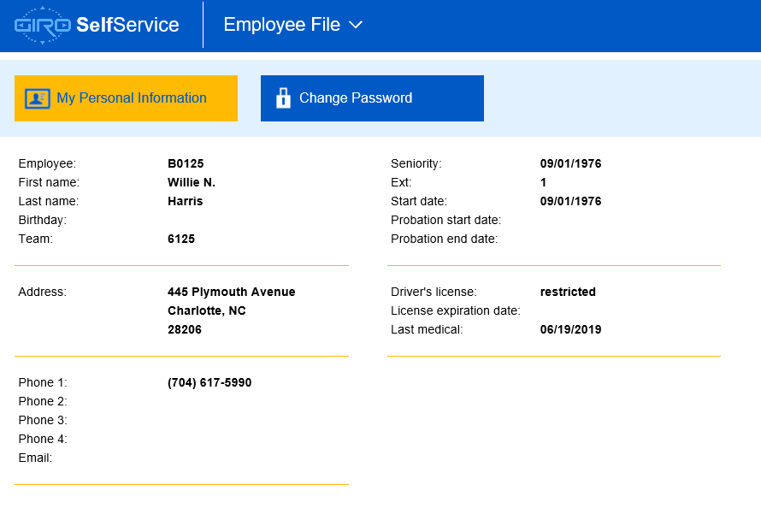
Employee File
Once successfully logged into the website, you will find the available bids for the coming run assignment.
You will also find the ‘Employee File’ section by clicking/pressing the drop down next to ‘Bid’
This section allows you to view general personal information
You can also change your password using the ‘Change Password’ link
1234 Melody Lane
Charlotte, NC
28224
13/12/2014
704-555-4554

Slide 6
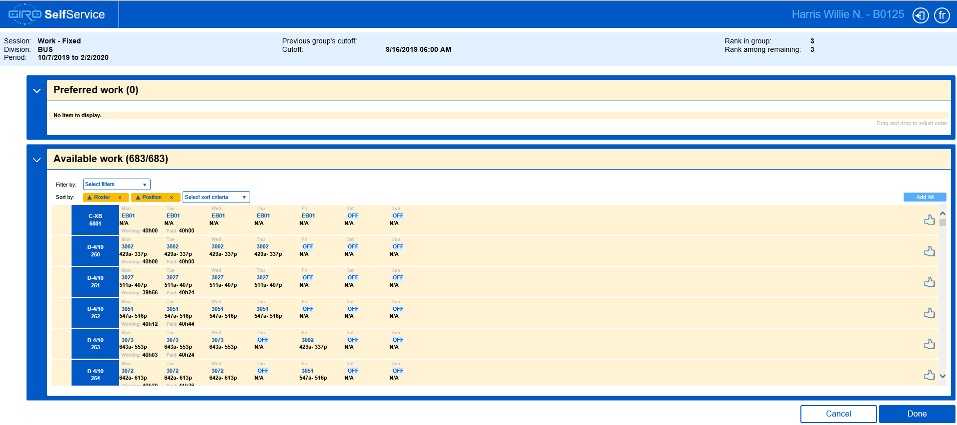
Selecting Your Bid Round
Bid rounds will be displayed in a tile format once you have logged in
Select the bid round you want to view by clicking/pressing on the tile
The bid window will display

Slide 7
Bid Page Details
Logout Button
Booking Dates
Cutoff Time
Group Rank
Available Work Summary
Filter and Sort Options
Work Week Details
Work Selection Button
Done/Save Button

Slide 8
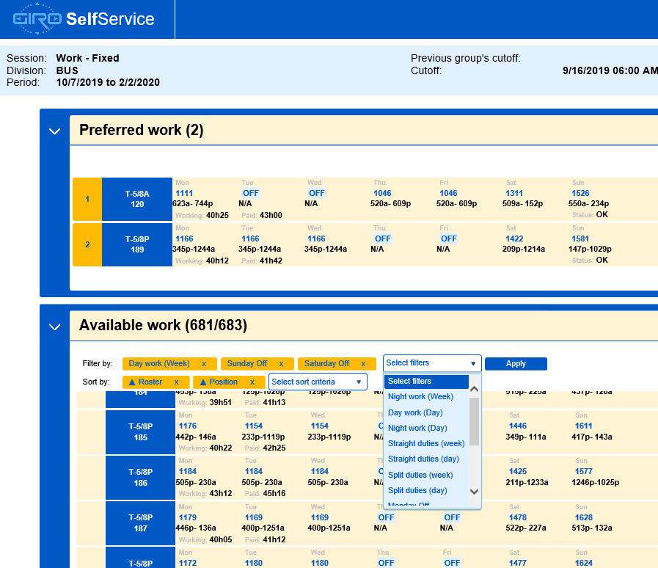
Available Work Filters / Sort Options
Available work can be sorted or filtered by the options listed
You can have multiple filters and sorting options selected
Clicking/pressing on the drop down icon on either field will display your options
Once all the options are selected, click/press the ‘Apply’ button for an updated list of available work
To remove an option, click/press the ‘X’ for each field to be removed, and then click/press the ‘Apply’ button for an updated list of available work

Slide 9
Available Work Details
The available work summary displays the general weekly summary of the position
By clicking/pressing on each week, you will see a more detailed view that can be narrowed down to the trip details for each day
Use the ‘Close’ button on the bottom right to get back to the selection screen

Slide 10
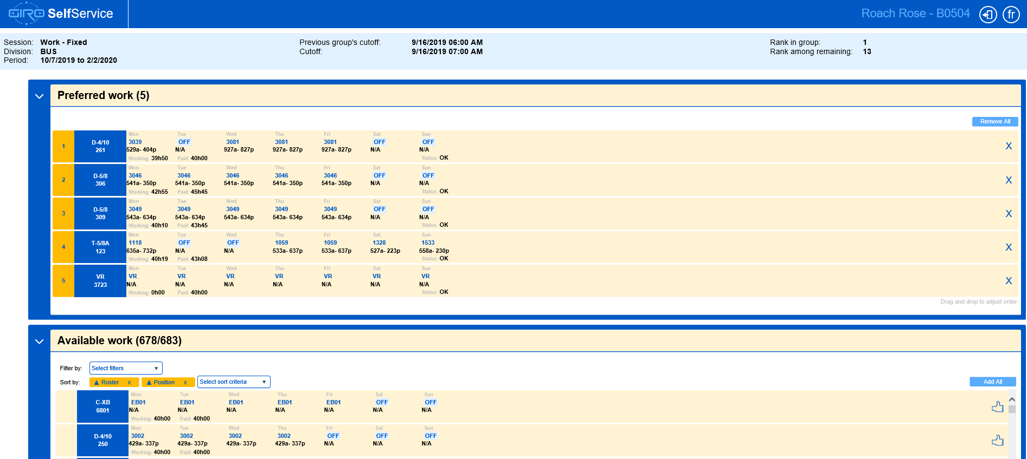
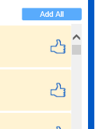
Selecting Available Work
When a work week looks interesting, move it from the ‘Available Work’ section, to the ‘Preferred Work’ section
This is done using the thumbs up icon on the work week summary
The goal is to select at least as many work week positions as the rank in the group
For example, if ranked 5th in the group, make no less than 5 selections
Preferred work choices have no limit, it is encouraged to make more choices than the rank in the group

Slide 11
Arranging Preferred Work
The Preferred work section list the desired work in order of selection, this list should be arranged to suite preferences

Slide 12
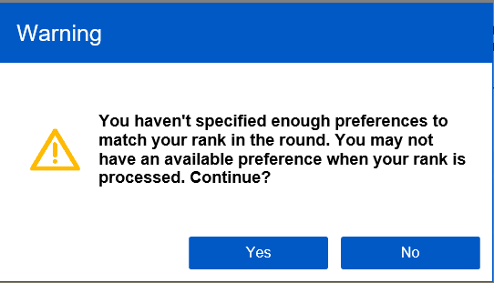
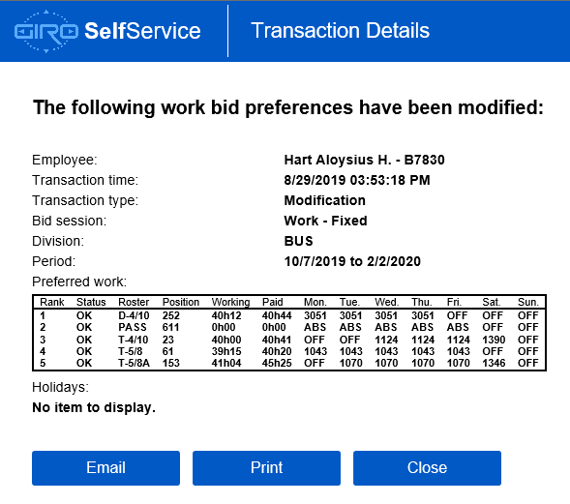
Reviewing Work Choices
Once completed making choices and arranging them in order, click/press the ‘Done’ button at the bottom right of the page
If less choices were made than the rank in the group, a validation message will appear, it will not stop the
The Transaction Details will display summarizing the choices made during the bid process
Choices will be saved and reviewable each time the website is accessed
If desired, the details can be printed to a local computer
The email function is currently not available

Slide 13
Awarded Work
Once work has been awarded, and after the cutoff time of the group, accessing the website will display the work details for the assignment for each day of the week

